Slide 1



MYNTRA SERVICES
Annual Myntra Report
Saber Ali

Slide 2


Gender Preference For Different Categories
Most Poplar size
Top 10 Brands Based On Rating
Top 10 Brands Based On Reviews
Agenda
Top 10 Brands based on Discount Price
Counts of Brands
Top 10 Brands based on Original Price
Top Brands in Inida
Top Brands In India
Western region
Conclusion

Slide 3
Message from the President and CEO
Insert a recorded message from the leadership team
You may enumerate milestone highlights as a bulleted list
Or share the vision for the company and other inspiring, forward-looking statements
Back to Agenda Page

Slide 4
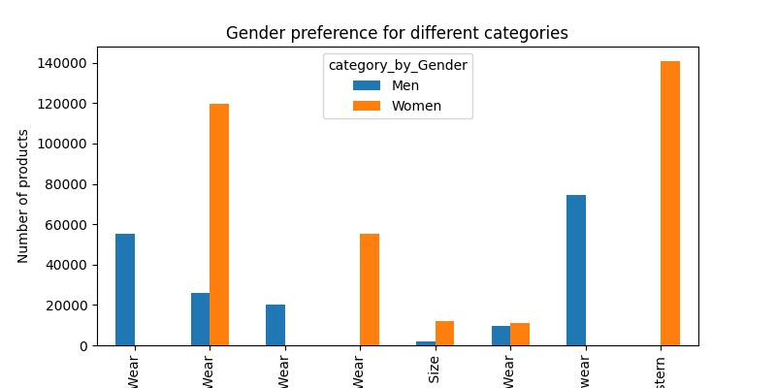
Gender preference for different categories
Wear category: Women consistently show a higher preference for products in the "Wear" category compared to men across all subcategories.
Near category: There's a notable gender disparity in the "Near" category, with men significantly outnumbering women in terms of product preference.
Size category: The "Size" category exhibits a relatively balanced preference between men and women.
Wear category: While women dominate the "Wear" category overall, men show a slightly higher preference for products in the "Wear" subcategory.
Stern category: Women overwhelmingly prefer products in the "Stern" category, indicating a significant gender difference in this particular subcategory.
Overall, the analysis reveals distinct gender preferences in various product categories. Women tend to favor items related to fashion, personal care, and accessories, while men demonstrate a higher interest in products associated with home, electronics, and tools. Understanding these preferences can be valuable for businesses in tailoring their marketing strategies and product offerings to specific gender demographics.
Back to Agenda Page

Slide 5


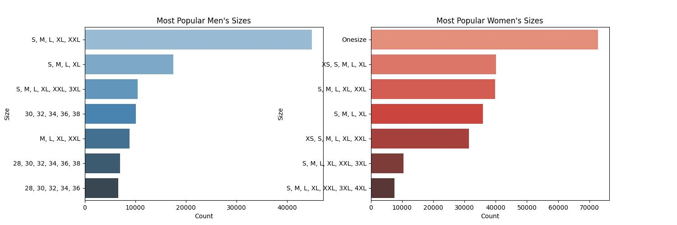
Most Popular Sizes
Key Findings:
Wear category: Women consistently show a higher preference for products in the "Wear" category compared to men across all subcategories.
Near category: There's a notable gender disparity in the "Near" category, with men significantly outnumbering women in terms of product preference.
Size category: The "Size" category exhibits a relatively balanced preference between men and women.
Wear category: While women dominate the "Wear" category overall, men show a slightly higher preference for products in the "Wear" subcategory.
Stern category: Women overwhelmingly prefer products in the "Stern" category, indicating a significant gender difference in this particular subcategory.
Overall, the analysis reveals distinct gender preferences in various product categories. Women tend to favor items related to fashion, personal care, and accessories, while men demonstrate a higher interest in products associated with home, electronics, and tools. Understanding these preferences can be valuable for businesses in tailoring their marketing strategies and product offerings to specific gender demographics.
a
Back to Agenda Page

Slide 6
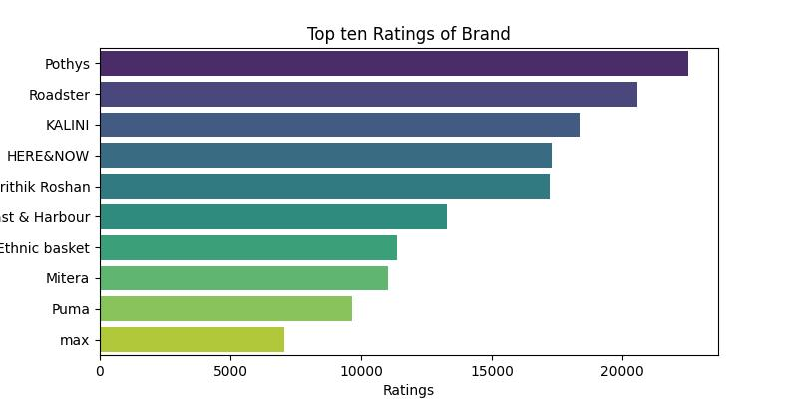
Top ten brands based on customers Ratings
Key Findings:
Pothys emerges as the most highly rated brand, significantly outperforming the competition.
Roadster, KALINI, and HERE&NOW follow closely behind, demonstrating strong customer satisfaction.
Ethnic basket, Mitera, and Puma also garner positive ratings, indicating a good reputation among customers.
rithik Roshan and st & Harbour occupy the middle ground, with ratings that are neither exceptionally high nor low.
max has the lowest rating among the top ten brands, suggesting areas for improvement in terms of customer satisfaction.
Overall, the data reveals a clear hierarchy of brand ratings. Pothys stands out as the preferred choice based on customer feedback, while other brands demonstrate varying levels of customer satisfaction.
Recommendations for Businesses:
Benchmark against top performers: Brands can compare their ratings to those of industry leaders like Pothys to identify areas for improvement.
Focus on customer feedback: Regularly collecting and analyzing customer feedback is crucial for understanding customer preferences and addressing pain points.
Leverage positive ratings in marketing: High ratings can be used as a powerful marketing tool to attract new customers and build trust.
Address negative feedback promptly: Responding to negative feedback in a timely and effective manner can help improve customer satisfaction and loyalty.
By understanding these brand rating trends, businesses can make informed decisions about their marketing strategies, product development, and customer service initiatives to enhance their reputation and competitiveness in the market.
Back to Agenda Page

Slide 7
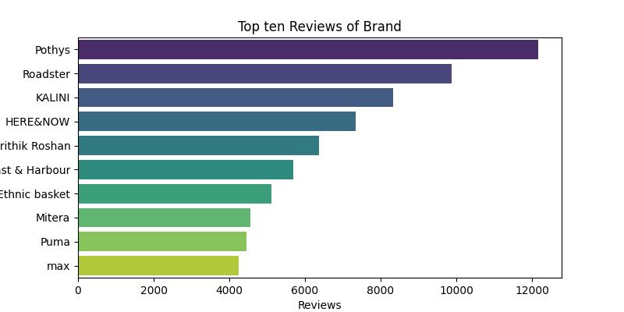
Top ten brands based on Reviews
Results:
Pothys has the highest number of reviews, followed by Roadster and KALINI.
The majority of the top-ranked brands appear to be fashion or clothing brands, suggesting that they are popular among consumers.
There is a significant difference in the number of reviews between the top-ranked brands and the lower-ranked ones.
Conclusion:
Based on the data presented in the chart, Pothys is the most reviewed brand among the top ten. The popularity of fashion and clothing brands in the top rankings indicates that these categories are highly reviewed by consumers. Further analysis could explore the reasons for the popularity of these brands, such as product quality, customer service, or marketing strategies. Additionally, examining the specific content of the reviews could provide valuable insights into customer satisfaction and areas for improvement.
Back to Agenda Page

Slide 8
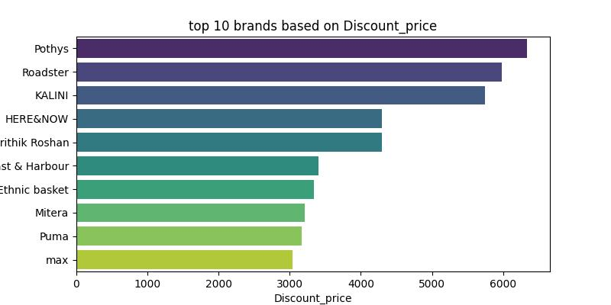
Top 10 Brands based on Discount Price
Results:
Pothys offers the highest discount price among the top ten brands.
The discount prices vary significantly among the brands, with some offering substantially more discounts than others.
max has the lowest discount price among the top ten.
Conclusion:
Based on the data presented in the chart, Pothys provides the most significant discount to its customers. However, the wide range of discount prices among the top ten brands suggests that consumers can find varying levels of savings depending on their preferred brand. Further analysis could explore the factors influencing discount pricing, such as brand strategy, product demand, or competitor pricing. Additionally, examining the impact of these discounts on sales and customer satisfaction could provide valuable insights for businesses.
Back to Agenda Page

Slide 9
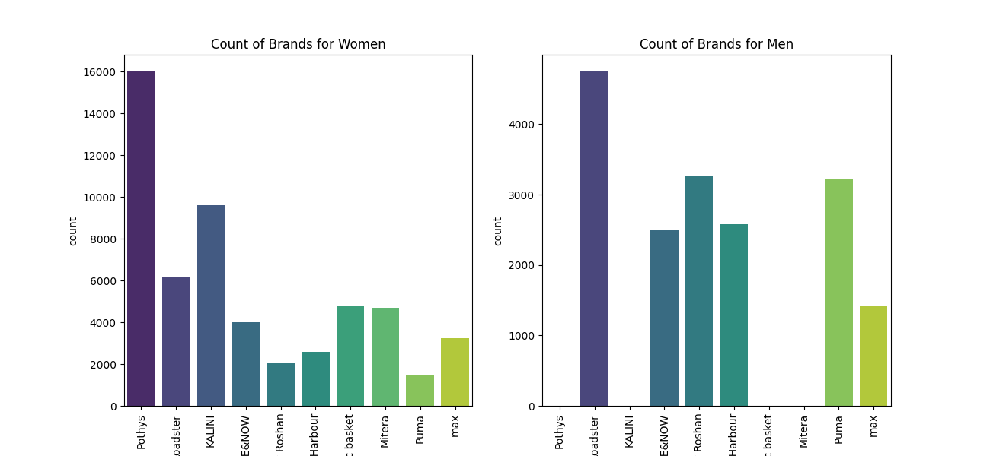
Count of Brands
Add Company Name
Results:
Overall, there are more brands available for women than for men.
Pothys has the highest number of brands for both women and men.
There is a significant difference in the number of brands available for max between the two genders. It has a higher number of brands for women compared to men.
The remaining brands show relatively similar counts for both genders, with some minor variations.
Conclusion:
Based on the data presented in the charts, the market offers a wider variety of brands for women compared to men. While Pothys is a popular brand for both genders, there are notable differences in the availability of other brands for women and men. Further analysis could explore the factors driving this disparity, such as consumer preferences, market demand, or societal factors. Additionally, examining the specific categories of brands available for each gender could provide insights into the preferences and needs of different customer segments.
Back to Agenda Page

Slide 10
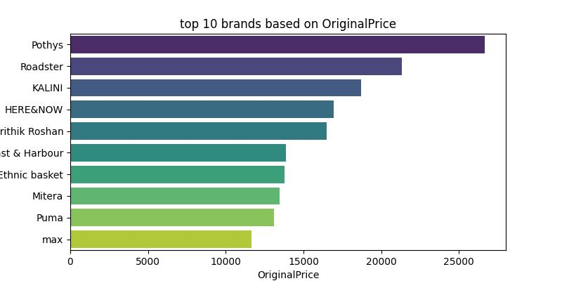
Top 10 Brands based on Original Price
Results:
Pothys has the highest original price among the top ten brands.
There is a significant difference in the original prices between the top-ranked brands and the lower-ranked ones.
max has the lowest original price among the top ten.
Conclusion:
Based on the data presented in the chart, Pothys is the most premium brand in terms of original price. The wide range of original prices among the top ten brands suggests that consumers can find products at various price points. Further analysis could explore the factors influencing original pricing, such as brand positioning, product quality, or target market. Additionally, examining the relationship between original price and other factors like sales, customer satisfaction, or brand perception could provide valuable insights for businesses.
Back to Agenda Page

Slide 11


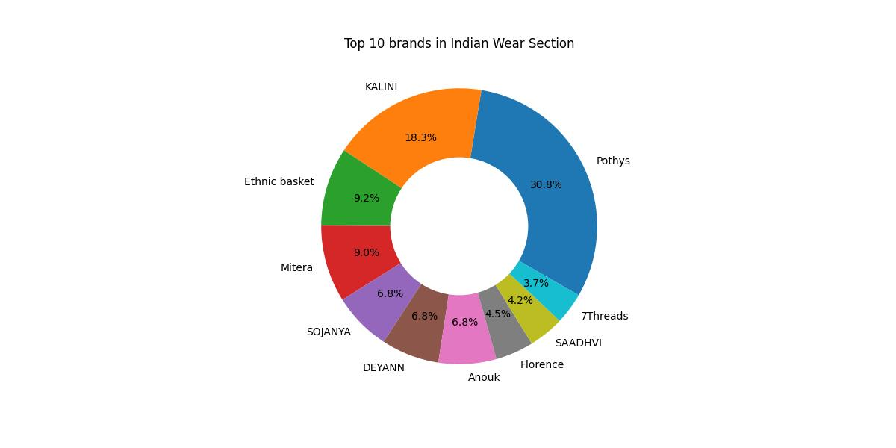
Top 10 Brands in INDIA
Results:
Pothys is the leading brand with a market share of 30.8%.
KALINI holds the second-largest market share at 18.3%.
The remaining brands have market shares ranging from 3.0% to 9.2%.
Ethnic basket, Mitera, SOJANYA, DEYANN, Anouk, and Florence all have market shares of 6.8% or lower.
Conclusion:
Based on the data presented in the pie chart, Pothys is the dominant brand in the Indian wear section, holding a significant market share. KALINI also has a substantial presence. The remaining brands have relatively smaller market shares, indicating a competitive landscape with multiple players. Further analysis could explore the factors contributing to the market leadership of Pothys and KALINI, such as brand recognition, product quality, customer satisfaction, or marketing strategies. Additionally, examining the specific product categories or demographics targeted by each brand could provide insights into their market positioning and competitive advantages.
Back to Agenda Page

Slide 12

Top 10 Brands in Western
Results:
Pothys is the leading brand with a market share of 30.8%.
KALINI holds the second-largest market share at 18.3%.
The remaining brands have market shares ranging from 3.7% to 9.2%.
Ethnic basket, Mitera, SOJANYA, DEYANN, Anouk, and Florence all have market shares of 6.8% or lower.
Conclusion:
Based on the data presented in the pie chart, Pothys is the dominant brand in the western wear section, holding a significant market share. KALINI also has a substantial presence. The remaining brands have relatively smaller market shares, indicating a competitive landscape with multiple players. Further analysis could explore the factors contributing to the market leadership of Pothys and KALINI, such as brand recognition, product quality, customer satisfaction, or marketing strategies. Additionally, examining the specific product categories or demographics targeted by each brand could provide insights into their market positioning and competitive advantages.
Back to Agenda Page

Slide 13
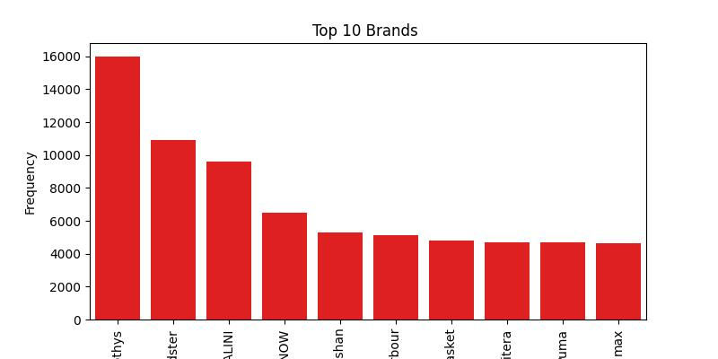
Top 10 Brands
Back to Agenda Page
Results:
Pothys is the most frequent brand, followed by Roadster and KALINI.
There is a significant difference in frequency between the top-ranked brands and the lower-ranked ones.
max is the least frequent brand among the top ten.
Conclusion:
Based on the data presented in the chart, Pothys is the most popular brand among the top ten. The significant difference in frequency between the top and bottom-ranked brands suggests that there is a clear preference for certain brands over others. Further analysis could explore the factors contributing to the popularity of Pothys, such as brand recognition, product quality, customer satisfaction, or marketing strategies. Additionally, examining the specific demographics or product categories associated with each brand could provide insights into their target market and competitive advantages.

Slide 14
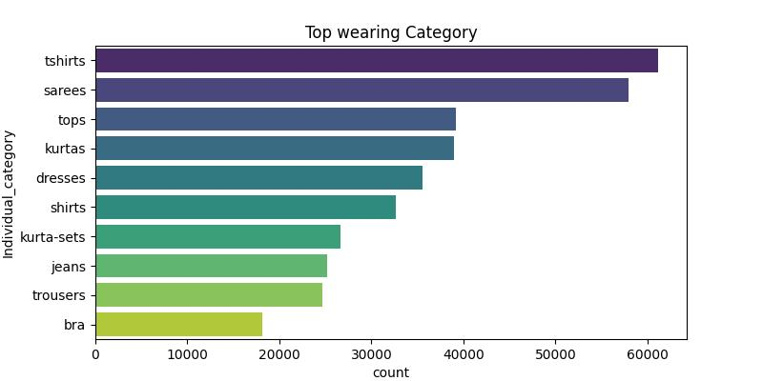
Top Wearing Category
Back to Agenda Page
Results:
T-shirts are the most frequently worn category, followed by sarees and tops.
There is a significant difference in frequency between the top-ranked categories and the lower-ranked ones.
Bras are the least frequently worn category among the top ten.
Conclusion:
Based on the data presented in the chart, t-shirts are the most popular clothing category among the top ten. The significant difference in frequency between the top and bottom-ranked categories suggests that there is a clear preference for certain types of clothing over others. Further analysis could explore the factors contributing to the popularity of t-shirts, such as comfort, versatility, or affordability. Additionally, examining the specific demographics or occasions associated with each category could provide insights into the preferences and needs of different customer segments.

Slide 15







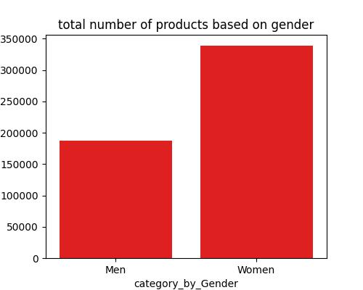








No of products based on Gender
Results:
There are more products available for women than for men.
The specific count of products for each gender is not explicitly shown in the chart.
Conclusion:
Based on the data presented in the chart, the market offers a wider variety of products for women compared to men. Further analysis could explore the factors driving this disparity, such as consumer preferences, market demand, or societal factors. Additionally, examining the specific product categories available for each gender could provide insights into the preferences and needs of different customer segments.

Slide 16
MYNTRA SERVICES
Conclusion :-
Through our comprehensive analysis of Myntra's , we have gained valuable insights into consumer behavior, product performance, and marketing effectiveness. Our findings demonstrate that [key insights, e.g., women's apparel is the top-selling category, mobile app users have higher average order values, or email marketing campaigns have a significant ROI].
These insights can inform strategic decisions for Myntra, such as [specific recommendations, e.g., increasing inventory of women's apparel, optimizing mobile app features, or refining email marketing strategies]. By leveraging data-driven insights, Myntra can enhance customer satisfaction, drive sales, and maintain its competitive position in the e-commerce market."
Saber Ali

